Slide 1

Headline Verdana Bold
Institute of Chartered Accountants of India
  Audit of the Future
18th December, 2019

Slide 2

Table of Contents
The Evolution in Technology
The Evolution in Financial Reporting
The Evolution in Auditing
      Audit Analytics
      Continuous Audit
      Artificial Intelligence
      Re-imagine audit: the future
ICAI – UAE Chapter
©2019 Deloitte & Touche (M.E.). All rights reserved.
Arab Media Group and its subsidiaries
2

Slide 3

The Evolution in Technology
3

Slide 4
The pace of technology change is outstripping human ability to adopt it
1900s
Tabulating System Era
Mechanical devices helped us with tasks such as organizing data and making calculations for tasks such as evaluating
the sales performances
of a company’s employees (Hollerith Tabulating Machine).
1950s
Programmable Systems Era
Programmable systems enabled major accomplishments such as space exploration and the development of the internet. The programmable systems era will continue indefinitely, and will underpin the era of computing that we are in now (Windows desktops/ERP systems).
2000s
Cognitive
Era
Cognitive capabilities augment and amplify human intelligence. It is critical to recognize and know when and how to automate and augment to achieve the competitive advantage.
2020s
Amplified Intelligence Era
In the future, systems will
be able to augment human intelligence and replicate human interactions.
4

Slide 5
Industry 4.0
History of industrial revolution from Industry 1.0 to 4.0
Industries across the world are catching on to the 4th wave of industrial evolution a.k.a Industry 4.0.
Just as the previous 3 waves, the 4th wave too is likely to transform the face of industries significantly and give them a quantum jump in reliability and efficiency.
Quick refresh of the earlier three waves and a brief description of the 4th is given below.
Industry 1.0
late 18th century
Industry 2.0
early 20th century
Industry 3.0
1970s
Industry 4.0
Today–near future
Electrification of production
Further automation in production by electronics and information technology
Mass production
Division of labor and wide use of electrical energy
Mechanical production
Replacing manpower by steam and water
Informatization of production
Cyber-Physical Systems allowing self-optimization and reconfiguration in production
5

Slide 6
Unprecedented change and opportunity
AI, Cognitive Computing, Robotics
Technology is everywhere
6.0 billion+
smartphones in the world by 2020
$500,000 in 2008
$22,000 today
7
Disruptors
Tsunami of data
Jobs vulnerable to automation
9x more in last 2 years
Major enabler of machine learning
35% UK
47% US
77% China
Diversity and generational change
Explosion in contingent work
Millennials 50%
25% global pop in Africa by 2050 ⁵
Longevity Dividend– 50 year careers
US Contingent workers 40% by 2020
Change in nature of a career
2.5 – 5 years: Half-life of skills
4.5 years: Average tenure in a job
6
Notes:
https://www2.deloitte.com/content/dam/Deloitte/ca/Documents/audit/ca-audit-abm-scotia-insights-from-impact-2018.pdf

Slide 7







What is Different ?
New technology has driven the development of Finance for decades, but now new disruptors are combining for rapid change
Foresight
New technologies (Cloud, Robotics, AI, Machine learning, Natural Language Processing, Blockchain)
Digital
Cloud
Visualization
Process Robotics
EPM
Advanced
Analytics
Cognitive
Computing
In-memory Computing
Blockchain
Insight
Reporting and
analytic software
Added Value
ERP
Mobile
devices
Profitability
analysis
Performance
tracking
Desktop
computing
Hindsight
Historical reporting on Key Performance Indicators
Data
Capture
Mainframes
Manual
Data storage to review prior performance
Data analytics
AI
1970
2000
2015
2020
7

Slide 8
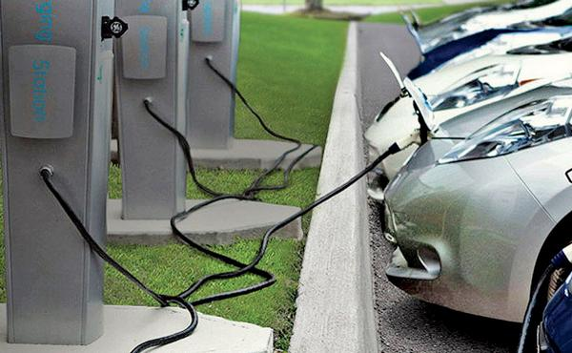



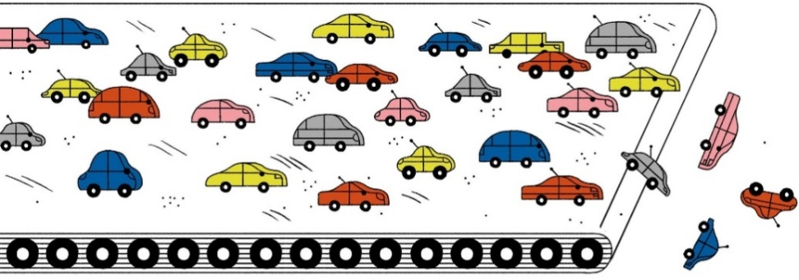
Interesting Predictions
Soon to be… - Electric cars
Electric cars are sold with lifetime guarantees and are only repaired by dealers.
It takes only 10 minutes to remove and replace an electric motor.
Auto repair shops will go away
Gas stations will go away
Electricity will become incredibly cheap and clean.
Cities will be less noisy and much cleaner as well.
8

Slide 9

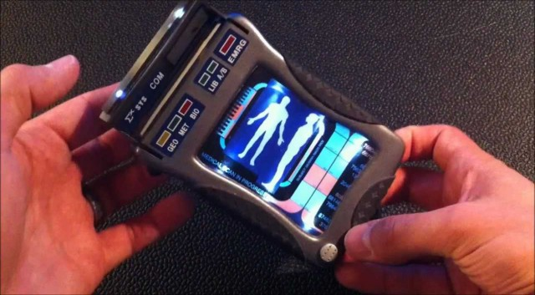
Interesting Predictions
Soon to be…
In 1998, Kodak had 170,000 employees and sold 85% of all photo paper worldwide.
Within just a few years, their business model disappeared and they went bankrupt. Who would have thought of that ever happening?
What happened to Kodak will happen in a lot of industries in the next 5-10 years … and most people don't see it coming.
There are companies who will build a medical device (called the "Tricorder" from Star Trek) that works with your phone, which takes your retina scan, your blood sample and you breath into it.
It then analyses 54 bio-markers that will identify nearly any Disease.
There are dozens of phone apps out there right now for health purposes.
9

Slide 10
Headwinds: Megashifts & disruptions
Illustrations…
A total number of 350 million active users have subscribed to Paytm contributing to over 1.5 billion transactions per quarter.
Revolutionary transformational developments are underway.
The only limitation is the ability to exploit them and not innovating at the speed of change
IBM Watson already helps nurses diagnosing cancer, its 4 times more accurate than human nurses
UBER is just a software tool, they don't own any cars, and are now the biggest taxi company in the world! Ask any taxi driver if they saw that coming.
Airbnb is now the biggest hotel company in the world, although they don't own any properties. Ask Hilton Hotels if they saw that coming.
10

Slide 11
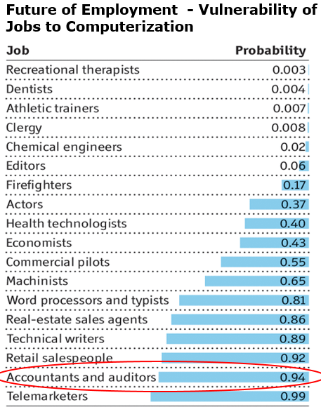
Accountants and Auditors
Welcome to tomorrow
– it actually arrived a few years ago!
The 2nd oldest profession has the 2nd highest chance of being irrelevant, anytime now!
11

Slide 12
6Bs bring blurred challenges
Borders/Base of
transactions
Business
models
Beneficiary
Beneficial owner
Bundled transactions
Business
identity
12
Notes:
Business models
Bundled transactions
Borders/Base of transactions
Business identity
Beneficiary
Beneficial owner

Slide 13
5Is impacting your business
Are you geared?
5 Is impacting your business
Information
Interface/
Integration
Intensity
Interpretation
Interrelation
13
Notes:
https://www.promptcloud.com/blog/big-data-influence-on-government-policy-making
Information [Quality and diversity]
Interpretation [Analysis]
Interface/Integration [Real time]
Interrelation [Connect the dots]
Intensity [Speed and volume]

Slide 14

Impact of collaboration with technology
What humans can accomplish alone
What humans
can accomplish
together
What humans
can accomplish
with tools
What humans
can accomplish
with data science and technology
What humans
can accomplish
with intelligent machines
14

Slide 15
The Evolution in Financial Reporting
15

Slide 16
Industry 4.0
What do modern investors seek?
Integrated Reporting
XBRL
Communicates how an organization’s strategy, governance, performance and prospects create value over time
Use of machine readable tags
Facilitates exchange of financial information
Improves quality of financial reporting
Expectation have gone “beyond numbers”
Focus on data which was ‘audited’
Need to evolve our reporting
Key Performance Indicators
Non GAAP measures
Insight into strategic matters
Meaningful glimpse
Helps predicting the future
Seeks to supplement existing accounting framework
Provides insight into management view on performance assessment.
16

Slide 17
Financial Reporting in an era of Industry 4.0
Reporting will be intelligent:
Tools like Artificial Intelligence reshape the future of forecasting
Predictive analytics and algorithms that will enhance the quality and value of reports.
Reporting will be interactive
Instead of having static data on paper, finance executives will use tablets and phones to navigate information.
Reporting tools themselves will become interactive, too.
Reporting will be real time
Why wait for the end of the quarter / year to get the data?
No more post-mortem – Data will get analyzed as it transacts
17

Slide 18
The Need for Finance Reporting - Past
Are we on track for the management review meeting next week?
Not quite. We’re having trouble getting a good set of numbers out of
Europe. I know Project Radius for our German R&D Center is going
live in a month’s time, but it looks like the data is a mess. I can’t
seem to get a good sense of where we are against budget.
Sounds familiar. Do you know when we’ll have that data?
You know the CEO wants an update on Europe, right?
I think we should be done in a week. I have my most
senior analysts working on it. We’re cutting it close but I
want to make sure we have the right information.
Keep me posted. I’d like to review this
information before I have to actually present it.
We’re doing our best.
CFO
Executive
CFO
Associate
CFO
Analyst
18

Slide 19
The Future Need of Finance Reporting
Alexa, what’s the FY18 year-to-date spend on Project Radius?
Year-to-date actual spend is $7.2M and is tracking under
budget by $300K. The under-spend is attributed to lower
spend on computer and networking equipment.
Siri, show me the computer and networking
equipment budget for FY18 for Project Radius with
comparisons to Project Jaguar for the same period.
Here are the charts you asked for. I’ve also
emailed you a PDF file for future reference.
I gotta say. This Google Assistant is just about the coolest thing
I’ve seen come out of Finance in forever. Good job getting
him up and running. Can he deliver that Europe budget
vs. actuals drill-down we talked about?
It’ll be in your inbox in five minutes.
CFO
Alexa
CFO
Siri
CFO
Google
19

Slide 20

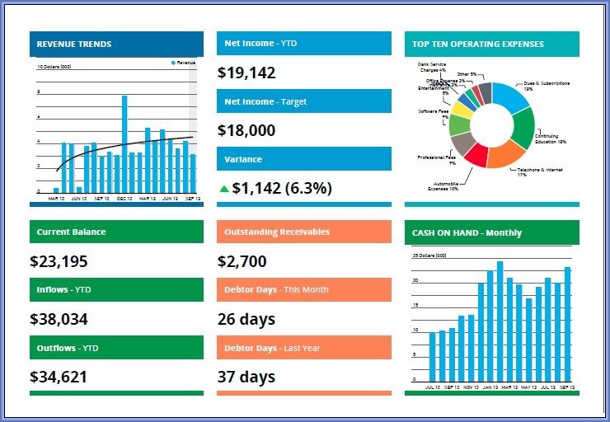
The Future of Reporting
From scouting-for-information to clicking-a-button
Standard disclosures
Generic narratives
Data, more data
Industry specific disclosures
Variances analysis, sector-specific ratios
Key information – with ability to go granular
20

Slide 21
The Evolution in Auditing
21

Slide 22
How have the Auditors evolved to make relevance
Annual Audits:-
Objective was to ensure that financial statements at the year end were fairly presented
Other information and Interim Reviews:
Changing expectations of investors lead introduction of “Other Information” paragraph
IFC Reporting
Growing business requirements lead to introduction of IFC reporting
Audit firms were now required to attest to the effectiveness of internal controls
Key Audit Matters
Used for providing insight to investors about most challenging aspects of audit.
Key Audit Matters
IFC Reporting
Other information and Interim Reviews
Annual Audits

Slide 23



Audit Evolution
Digital Audit- An Evolution
Early 1950’s
1950-1960
1960-1970
1970’s-2002
Present
Firms became aware of the needs of mechanisms of fraud detection and Financial accountability. However, audit tasks like physical inspection of inventories and confirmation of receivables was optional until fraudulent activities were detected
Auditing changed from relying on data provided by management personnel to auditing the business. Following the same, inspection and observation became the norm.
Increased automation in accounting paved it’s way to auditing through the computer which involves actual use of computer system in testing both controls and transactions
Increasing scandals during the early 1970’s .Such incident prompted the review of existing audit processes in an effort to address internal controls and audit procedures for information systems. Accounting firms then employed EDP specialists to audit information systems.
Increased usage of various Data Analytics tools which resulted in a considerable increase in audit quality and speed while dealing with increased data associated with automated systems
23
Notes:
The Equity Funding Corporation scandal of 1973 is sometimes perceived as the single most significant event in EDP audit history. In particular, the organization committed acts of fraud between 1964 and 1973 (Seidler et al. 1977). Essentially, managers created false insurance policies and commission income to artificially inflate profits and stock price and used a variety of mechanisms to conceal the activities. For example, when auditors attempted to confirm receivables via phone calls to customers, switchboard operators at Equity Funding would simply connect the calls to employees who would subsequently confirm the balance information. When the fraud was eventually unearthed in 1973, Equity Funding had $2 billion in phony insurance policies and this reflected roughly 67 percent of the total balance in that general ledger account. In reflection, it was determined that an EDP audit would uncover the fraud much sooner. This determination was made primarily because all of the false policies were posted to department number 99, whereas legitimate policies were not applied there.

Slide 24
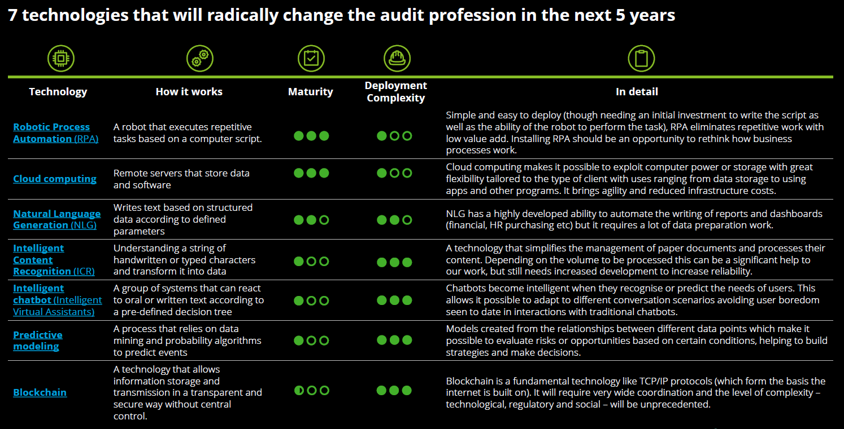
7 technologies that will radically change the audit profession in the next 5 years
24

Slide 25
Toolsets that provide opportunities for change
Foundation
Analytics
Robotic
Cognitive intelligence
Data integration
Integrated data to
provide consistent
Information.
Data visualization
Software placing data
in a visual context
Predictive Analytics
Software solutions using
predictive models
Artificial intelligence
Applications that mimic
human behaviour; acts as a support system for audit.

Slide 26
Audit Analytics
26

Slide 27
What is Audit Analytics?
Data analytics encompasses discovering and analyzing patterns, highlighting outliers, identifying exceptions, and extracting other useful information from data through computer-assisted techniques.
Audit analytics is using the tools and principles of data analytics for the purpose of planning or performing an audit.
27

Slide 28
What does Audit Analytics Include?
Audit Analytics is the science and art of the following:
Discovering Patterns
Visualizing Data
Identifying Outliers
Revealing Relationships
Developing Expectations
28

Slide 29
Examples of Audit Analytics Methods
Population Analysis
Automation of Manual Procedures
Recalculations
Types of Audit
Analytics
Journal Entry Testing
Reconciliations and Roll Forwards
Data
Visualizations
29

Slide 30
Benefits of Audit Analytics
Value/ Insight
Quality
Efficiency
Improved understanding of data
Testing of entire populations
Targeting items in a population with a higher likelihood of misstatement
Testing more of a population in less time
Reducing time spent of areas less likely to be materially misstated
Automated nature of testing
Increased understanding of relationships
Using visualizations to recognize patterns
More meaningful discussions with Management and TCWG
30

Slide 31
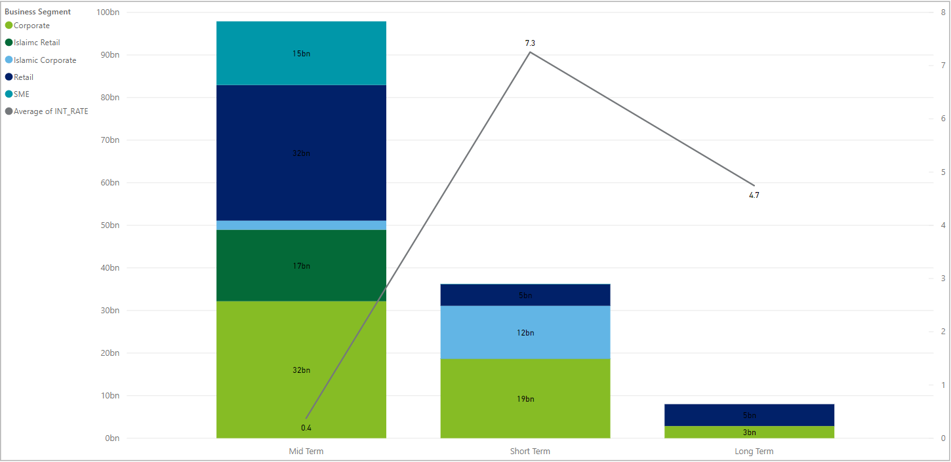
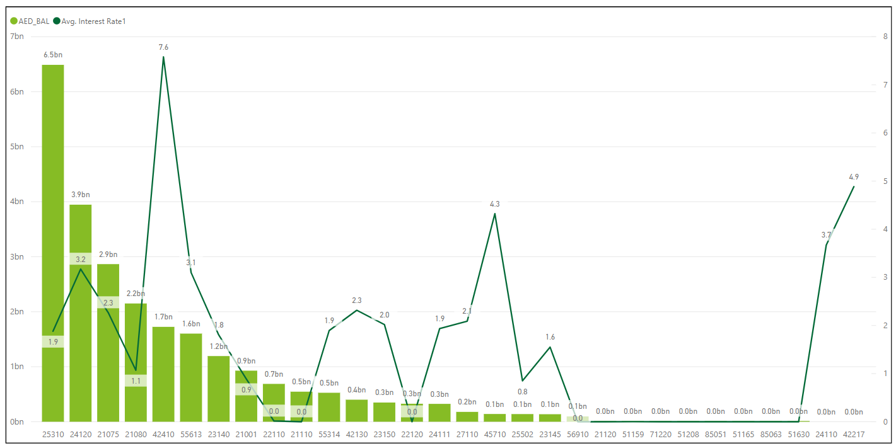
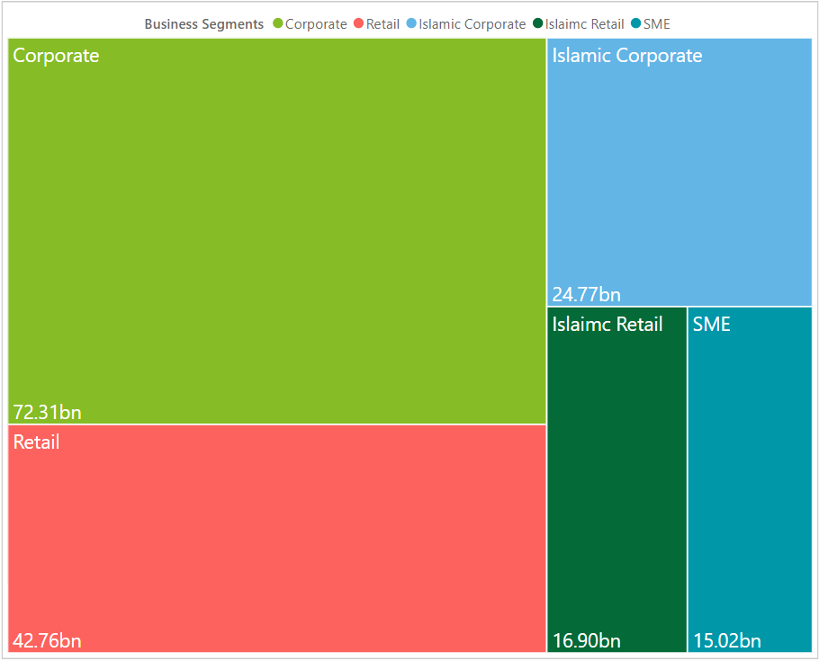
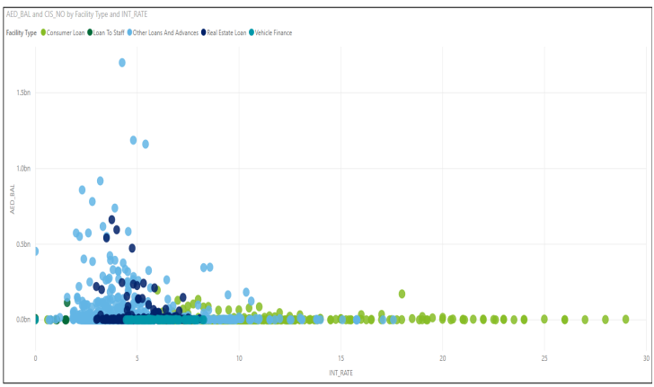
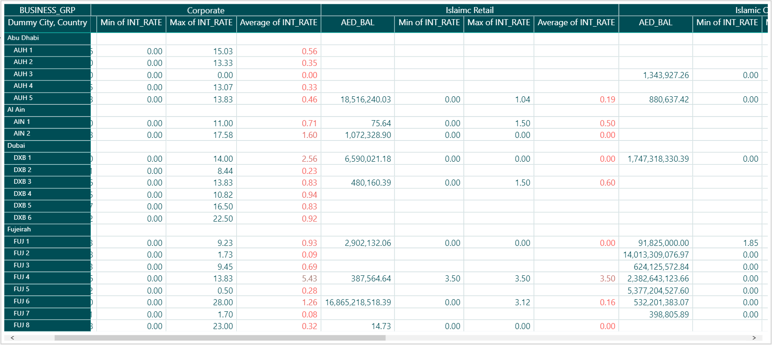
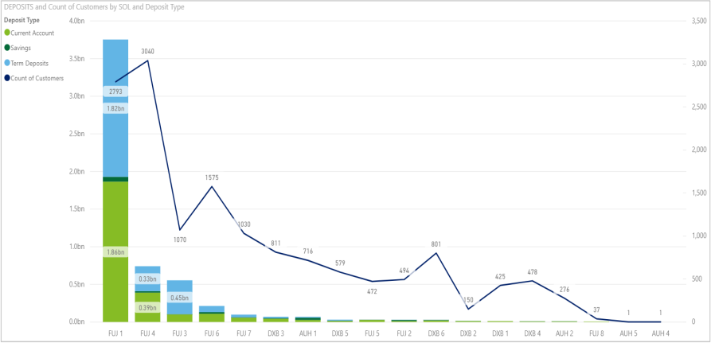
Analytics Tools | Spectrum
Spectrum
Spectrum is an analytical tool that puts visual analytics at the auditor's fingertips, enabling us to visualize and analyze client data. The tool allows us to quickly discover patterns and financial trends through a single unified view of linked and interactive visualizations, allowing for a fact-based audit risk assessment. The solution aids audit teams to incorporate exploratory data analytics into their audits, enabling higher quality in a cost-effective, efficient.
31

Slide 32
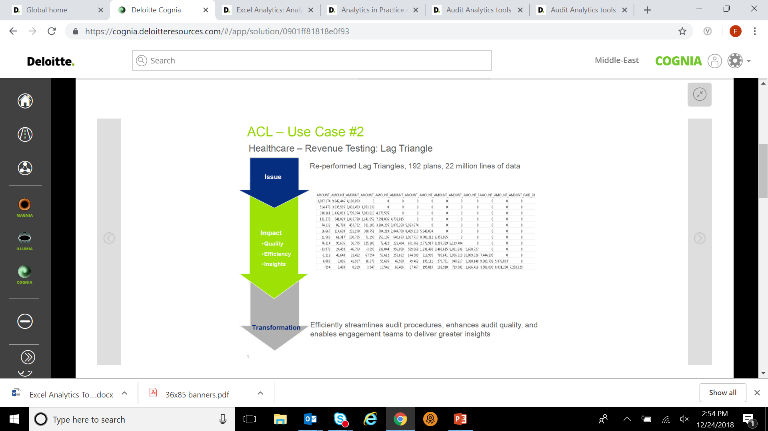


Analytics Tools | Audit Command Language (ACL)
Audit Command Language (ACL)
Market-leading technology and services for data inquiry, analysis, and reporting. ACL performs queries and data manipulation of large data sets without requiring extensive manual data preparation.
Allows unconstrained analyses on your data files. ACL has the ability to test large data sets to identify patterns or anomalies that could indicate hidden risks and enable the engagement team to focus on items of highest audit interest.
Destination System
Audit Command Language (ACL) Environment
IT
Department
Deloitte
Technical
Logic
Data Analytics logic
Deloitte computed
variance report
Source Systems
Our analytical procedures are performed using the Audit Command Language (ACL) tool, and dedicated Data Analytics server located in the UAE.
32

Slide 33
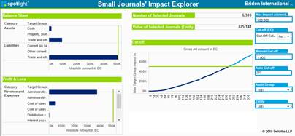
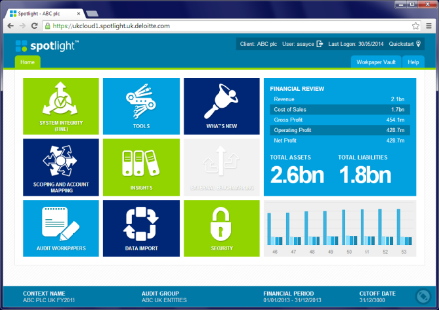
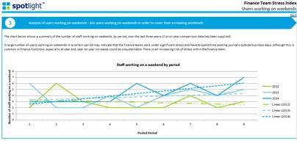
Analytics Tools | Spotlight
Spotlight
Spotlight is Deloitte’s market leading audit analytics platform. Accessible from any Deloitte laptop or iPad and using data downloaded from the client accounting system, it allows the audit team to populate workpapers, run insight reports and benchmark against our other clients anonymously, all within a secure environment. Spotlight allows to perform analytics that would not otherwise be possible. For example we can analyze posting patterns within the year to identify unusual trends and other matters of interest that may indicate error or fraud within an account balance, allowing us to focus our risks. Our analytics are highly customizable which means that we can focus on the risks that are applicable for you.
33

Slide 34

Data Visualization
Data visualization is simply the graphical or pictorial representation of data used to enable decision-makers to more easily grasp complex issues or understand patterns, trends, and correlations.
Leading audit functions are embracing recent enhancements in data mining technology and data visualization tools to deliver results more dynamically in response to risk, dive deeper into organizational data, and deliver profound fact-based insights.
34

Slide 35
Continuous Audit
35

Slide 36
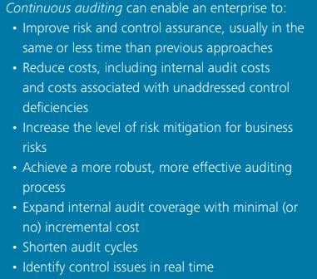
Continuous Audit
Continuous auditing is an automatic method used to perform auditing activities, such as control and risk assessments, on a more frequent basis. Technology plays a key role in continuous audit activities by helping to automate the identification of exceptions or anomalies, analyze patterns within the digits of key numeric fields, review trends, and test controls, among other activities.
The "continuous" aspect of continuous auditing and reporting refers to the real-time or near real-time capability for financial information to be checked and shared. Not only does it indicate that the integrity of information can be evaluated at any given point of time, it also means that the information is able to be verified constantly for errors, fraud, and inefficiencies. It is the most detailed audit.
36

Slide 37
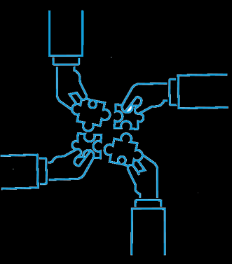
Three components of Continuous Audit
Continuous data assurance
Continuous data assurance verifies the integrity of data flowing through the information systems.
Continuous controls monitoring
Continuous controls monitoring consists of a set of procedures used for monitoring the functionality of internal controls.
2
1
“Breaking the mould”
Continuous risk monitoring and assessment
Continuous risk monitoring and assessment is used to dynamically measure risk and provide input for audit planning.
3
37

Slide 38
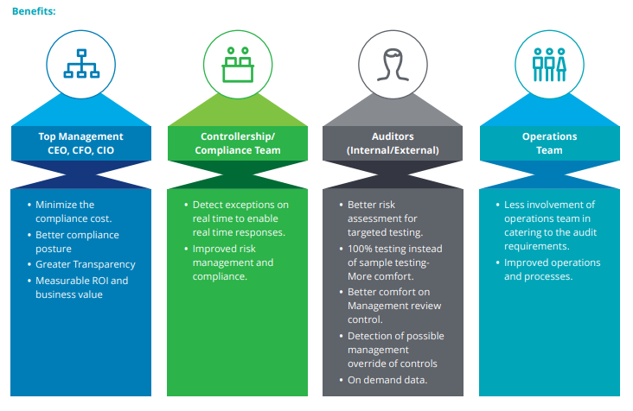
Benefits of Continuous Audit:
38

Slide 39
Artificial Intelligence - What is it?
39

Slide 40

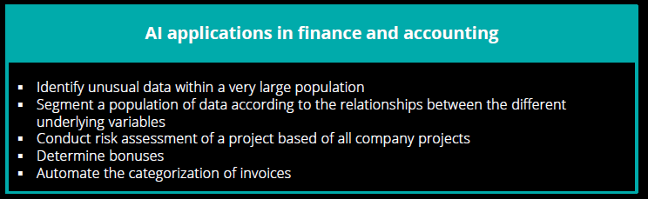
Artificial intelligence
Artificial intelligence (AI) makes it possible for machines to learn from experience, adjust to new inputs and perform human-like tasks. Most AI examples that you hear about today – from chess-playing computers to self-driving cars – rely heavily on deep learning and natural language processing. Using these technologies, computers can be trained to accomplish specific tasks by processing large amounts of data and recognizing patterns in the data.
40

Slide 41
Technologies and real life examples of Artificial Intelligence
Technology | How it works | Maturity | Deployment Complexity | Examples
Robotic Process Automation (RPA) | A robot that executes repetitive tasks based on a computer script |  |  | E-mail query processing Customer order processing Payroll Processing
Artificial Neural Networks | Information processing model that is inspired by the way biological nervous systems, such as the brain, process information |  |  | Optical Character Recognition Cursive Handwriting Recognition Speech Recognition
Natural Language Processing | The application of computational techniques to the analysis and synthesis of natural language and speech |  |  | Smart Assistants such as Siri and Alexa Predictive text such as autocorrect and autocomplete Digital phone calls (ever wonder what that “this call may be recorded for training purposes” means?)
Predictive Modelling | A process that relies on data mining and probability algorithms to predict events |  |  | Financial modeling to improve daily operations Analytics on Social Media Fraud Detection based on customer activity
Intelligent chatbot (Intelligent Virtual Assistants) | A group of systems that can react to oral or written text according to a pre-defined decision tree |  |  | Smart replies by Gmail Customer Service Chatbots Virtual Companions
41
Notes:
Cloud Computing is business technology capabilities delivered as a service. This allows for greater flexibility & scalability while also reducing up-front investment
Visualization is the innovative use of images and interactive technology commonly generated into an easily managed dashboard, allowing end users to explore large, high-density data sets
RPA is the automation of transaction processing across technologies. ‘Bots’ perform recurring processes more efficiently and with less risk of errors
Blockchain is a digital distributed ledger. Transactions are verified by all participants and securely stored on a network of distributed and connected nodes, thus eliminating the need for third party intermediaries (e.g., banks)
Advanced Analytics helps tackle the crunchy questions by sourcing greater volumes of data and performing more rigorous pattern recognition and prediction using data science
Cognitive Computing simulates human thinking and judgment based work. Advancements in machine learning, natural language generation, speech recognition and computer vision are broadening opportunities for automation
Internet of Things The Internet of things is the network of physical devices, vehicles, home appliances, and other items embedded with electronics, software, sensors, actuators, and connectivity which enables these things to connect, collect and exchange data.

Slide 42
AI is transforming the accounting industry by processing vast amounts of client data to report on behavior, trends and anomalies. For auditing, AI offers advanced methods for understanding ledgers, detecting material misstatements, and reporting on risk to clients.
How AI Helps Auditors
Artificial intelligence automates many tasks that were previously done manually, such as ingesting data, and it analyzes 100% of the dataset without requiring a human to create tests, write scripts, or remember all the rules.
Key to the future of audit is that AI is changing the definition of reasonable assurance, by understanding the entirety of the ledger and identifying anomalies based on risk, rather than rules.
AI-based systems are also continually learning and adapting to the data. As more information is entered and processed, AI analyzes secondary data and cross-correlates with the support of hundreds of variables
With risk-based assurance, transactions are flagged for investigation based on how they deviate from the data set, such as unusual payments or activities that would not normally be caught by traditional testing practices. While humans rely on judgement and random sampling, which can be time consuming and prone to missing items, AI rapidly parses information to reveal risks never thought of before.
AI-based systems are also continually learning and adapting to the data. As more information is entered and processed, AI analyzes secondary data and cross-correlates with the support of hundreds of variables.
42

Slide 43
Will AI replace accountants? The answer is definitively “no.”
It cannot replace the experience and judgement of auditors, nor can it understand and manage the relationships between firms and clients.
AI works alongside people, automating and accelerating large and complex data tasks and it assists with decision making when it comes to identifying misstatements and determining risk. It is transformative technology, and therefore any firm must carefully consider their adoption strategy and timelines.
"In the next 10 years, AI will not replace managers, but managers who use AI will replace those who do not.” (Brynjolfsson& McAfee)
43

Slide 44
Re-imagine audit – the future
44

Slide 45
Re-imagine Audit: Three factors for driving change
Mindset
There’s no criticism in the observation that auditors are typically conservative, traditional, and resistant to change.
However, 21st century auditing requires a new way of thinking that values innovation, fosters creativity, and embraces technology.
Those who fail to keep up with the rapid changes in the profession will quickly be marginalized.
Exploring Digital
Doing Digital
Becoming Digital
Being Digital
Leverage traditional technologies to automate existing capabilities
Leverage digital technologies to extend capabilities, but still largely focused around current business, operating and customer models
Leverage digital technologies - becoming more synchronized and less siloed - with more advanced changes to current business, operating, and customer models
Digital is not something separate. It is completely woven into the fabric (DNA) of the organization
45

Slide 46


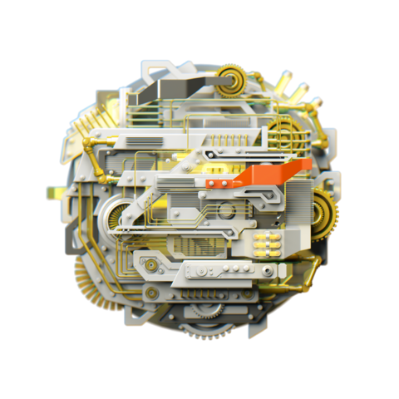
Re-imagine Audit: Three factors for driving change
For audit organizations that intend to exploit the power of Digital, three factors will influence the ease of adoption and the quality of outcome:
Mindset
Skillset
Toolset
46

Slide 47
Re-imagine Audit: The Future
Auditing and Automation
New technological tools have the potential to enable the auditor to mine and analyze large volumes of structured and unstructured data related to a company's financial information. This capability may allow auditors to test 100 percent of a company's transactions instead of only a sample of the population.
Through the use of artificial intelligence, robotic systems could interface with a client's systems to transfer and compile data automatically, something previously done manually by a junior auditor.
Auditors will be able to correlate disparate data information to develop predictive indicators to better identify areas of higher risk, which in turn could lead to early identification of fraud and operational risks.
The auditor should have more time to carefully examine the more complex and higher risk areas that require increased auditor judgment and contain high levels of estimation uncertainty.
47

Slide 48






Audit Evolution
The “Future” audit team
Manager
Tax expert
Staff 1
Audit Data Center Expert
IT Specialist
Cyber Security Expert
Data analytics expert
Audit partner
48

Slide 49
ICAI – UAE Chapter
49

Slide 50
UAE Demographics
Sharjah
Ajman
Dubai
Fujairah
Abu Dhabi
Pop
9.3m
GDP $415.2b
Inflation 2.6%
GDP Growth
1.7%

Slide 51
ICAI Membership
ICV Project
  Visa restrictions
Barriers to entry for the Profession
Corporate Finance
VAT
  Examination requirements
  Registration and Legal requirements
Job
Opportunities
Consultancy
Internal Audit
  Alternative Degree Options
  (CPA, ACCA, ICAEW)
External Audit
51

Slide 52
ICAI | Middle East Demographics
Members Bifurcation
Middle East
Members
UAE
Members
Categorization in
each country:
Sectors having
maximum members:
Approximately 11,000
Approximately 5,000
Industry- 70%
Practicing-25%
Banking- 5%
1. Real estate and construction
2. Oil and Gas
3. Wholesale and retail
Other sectors-
FSI, Shipping, Hospitality, etc
52

Slide 53
ICAI | Dubai Demographics
Position Wise
Organizations
Large Corporates
Nestle
Emaar
Nakheel
Siemens
Pepsi
Coco Cola
Large Groups
Al Ghurair Group
Galadhari Group
EMKE Group
IFFCO Group
Al Shirawi Group
Al Rostamani
2900 +
Number of members
1450 +
Number of organizations
Large FSI
Emirates NBD
Mashreq
HSBC
FAB
Gargash Insurance
IT & Telecom
Oracle
SAP
Tally
DU
Etisalat
40 +
Number of events
53

Slide 54
ICAI | Abu Dhabi Demographics
Position Wise
Large Corporates
160
ADIA
ETIHAD
BANKS (FAB,ADCB,UNB )
LULU
NMC
UAE EXCHANGE
AUDIT FIRM (KPMG,DELOITTE,ARDENT,PKF)
ETISALAT
AL NASAR HOLDINGS
MUBADALA
ADNOC
Senior Mgt Level (CEO/MD/DIR ETC)
525
Middle Mgt Level
(Fin Mgr/Senior Mgr)
250
Senior Executive Level
54

